Slide 1
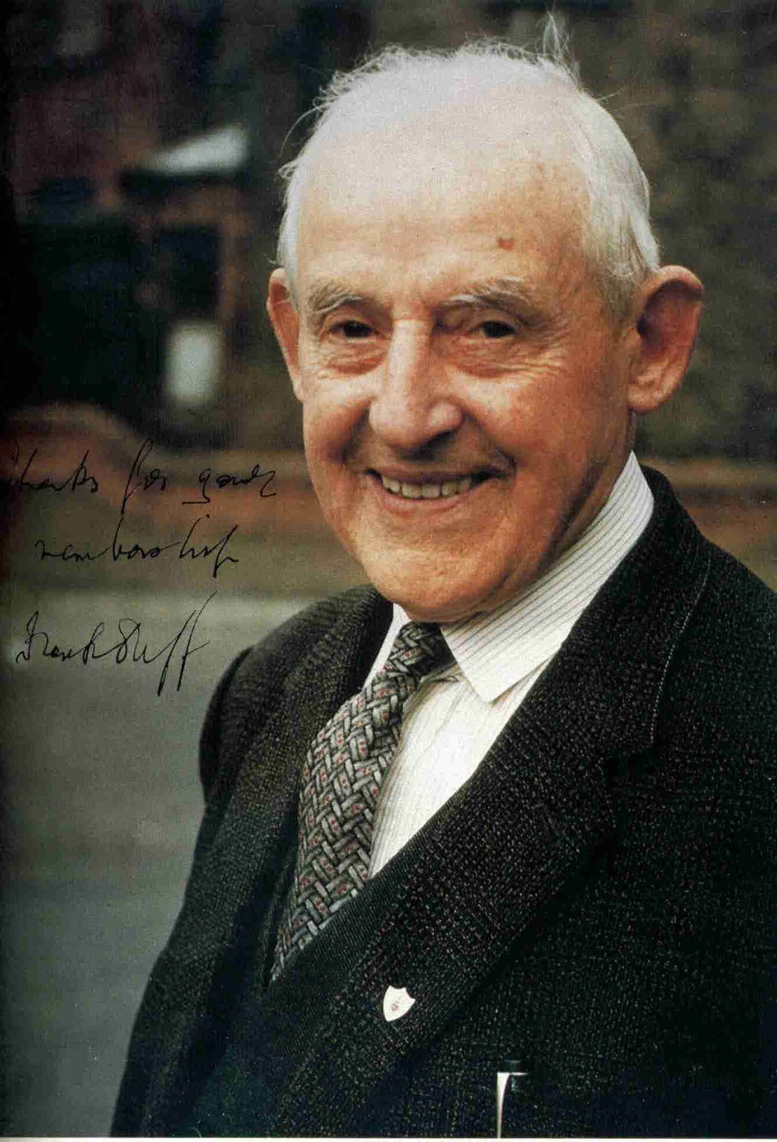
Servant of God, Frank Duff
Founder of the Legion of Mary
June 7, 1889 – November 7, 1980
Notes:
This presentation is based primarily on information taken from the following books: “Frank Duff” by Fr. Robert Bradshaw, “Frank Duff: A Biography” by Leon O’Broin, and “A Living Autobiography”, edited by Msgr. Charles Moss.

Slide 2
Early Life
Notes:
We’ll begin with the early life of Frank Duff.

Slide 3
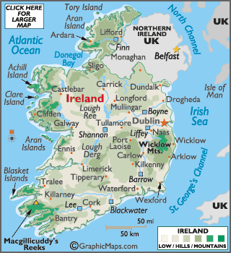
Francis Michael Duff was born on June 7, 1889 in Dublin, Ireland
Dublin, Ireland
Notes:
Francis Michael Duff was born on June 7, 1889 in Dublin, Ireland, about one mile north of the present Legion of Mary headquarters.

Slide 4
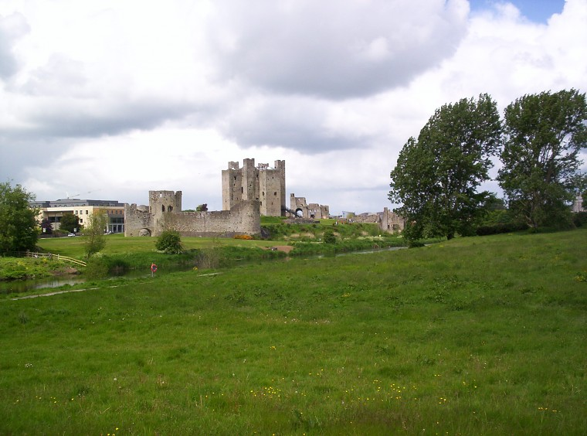
Family Background
Michael Francis Frehill:
Lived in Trim, County Meath, Ireland
In 1849 he became the 1st Catholic headmaster of a state-run school since Penal Laws were enacted 150 years before
He had three sons and one daughter, Susan Frehill
Trim, County Meath, Ireland
Notes:
(2 clicks) Frank’s grandfather, Michael Francis Frehill, was headmaster of Model School in Trim, County Meath, Ireland. (click) He was the first Catholic headmaster of a state-run school in over 150 years. (click) He was the father of four: three sons and one daughter, Susan Frehill.

Slide 5
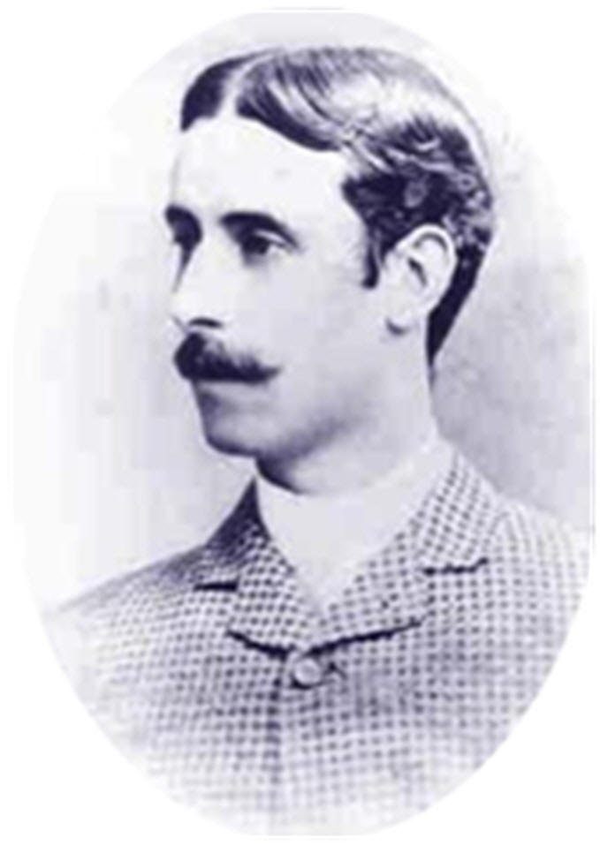
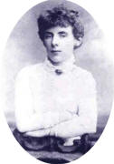
Parents
John Duff
“Jack”
Susan Letitia Frehill
“Letty”
Notes:
(click) Susan was a talented young woman. She passed the first Civil Service exam open to women and took a post in the British Civil Service which covered England and Ireland. After working for a time in London, she was transferred to Dublin where she met John Duff, (click) another Civil Servant. John had been a former pupil of Michael Frehill.

Slide 6
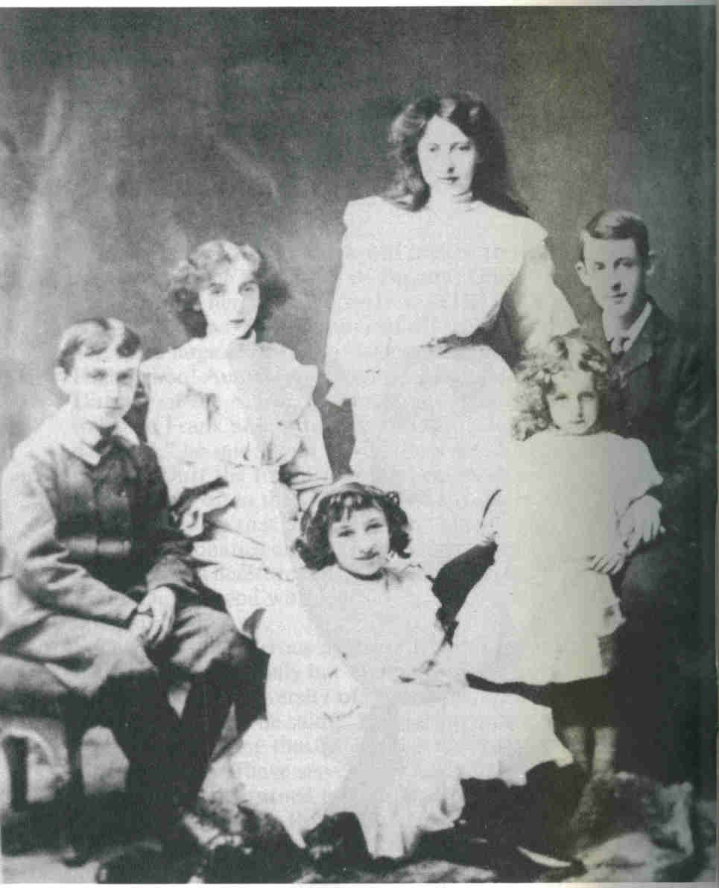
Siblings
Francis Michael
Isabel
Letitia & Eva
John
Sara Geraldine
Ailis
Notes:
(click) The couple married in 1887 and had seven children. (click) Frank was the eldest. (click) Next was his sister Isabel who suffered from ill health. (click) Then came twins, Laetitia and Eva. Eva died in infancy and Laetitia died of tuberculosis at the age of 13. (click) Frank’s brother John went into Civil Service and eventually became secretary of the Department of Justice. (click, click) His youngest sisters, Sara Geraldine and Ailis both became doctors.

Slide 7
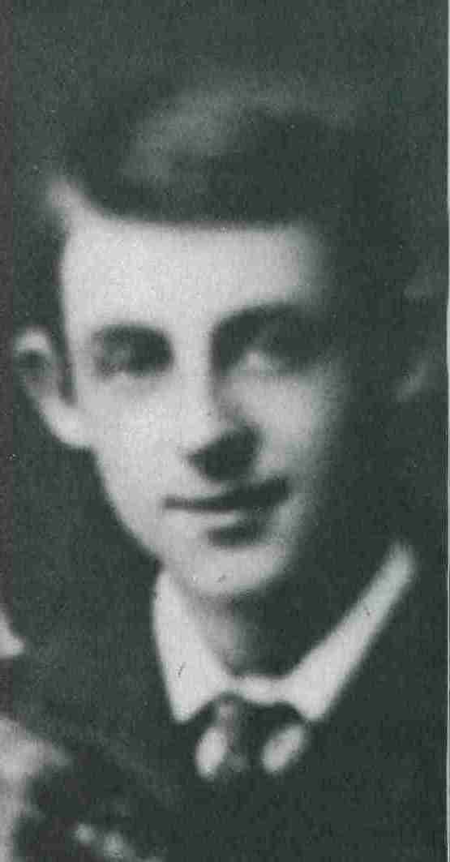
Frank’s Youth
Student
Runner
Cyclist
Athlete
Notes:
Most of Frank’s schooling took place at Black Rock College, where he was taught by the Holy Ghost Fathers. He didn’t particularly like school, especially Math. (click) He studied Irish, English, Greek, Latin, and French. (click) Frank enjoyed the outdoors and was a swimmer and a runner. (click) Inspired by his father’s love of bike-riding, Frank became a cyclist at an early age. (click) He played tennis and cricket and, at the age of 12, suffered permanent damage to his hearing when he was hit in the left ear by a cricket ball.

Slide 8
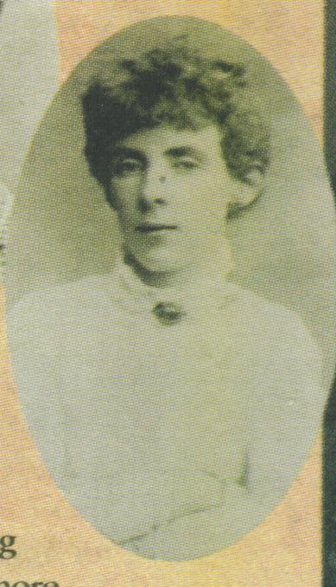
Mrs. Duff
Through his relationship with his mother, “Frank acquired wonderful and enriching insights into the meaning and beauty of true motherhood.”
- Fr. Bradshaw
Notes:
Frank had a close relationship with his mother. She was an accomplished pianist and gave him a love for music and for reading. They spent time together traveling, shopping, and going to the theater. They were best friends. In his biography of Frank Duff, Fr. Robert Bradshaw notes that this relationship gave Frank “wonderful and enriching insights into the meaning and beauty of true motherhood” which certainly added to his relationship with our Blessed Mother.

Slide 9
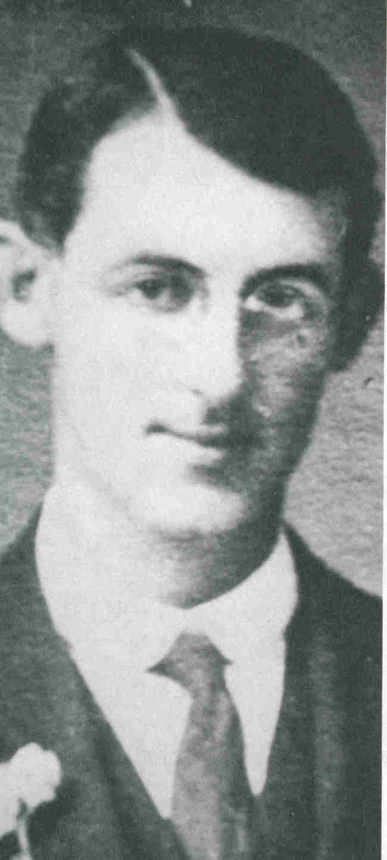
Breadwinner
John Duff became ill
Frank passed Civil Service Exam in 1908
John Duff died on December 23, 1918
Notes:
(click) Frank’s father, John Duff was ill and it was necessary for Frank to become the breadwinner of the family. (click) Like both of his parents, he went into Civil Service. He worked hard to train himself, particularly in math and science. In fact, at the age of 21, he invented a system of calculus which was eventually adopted by the London Treasury. (click) Frank’s father died on December 23, 1918.

Slide 10

Civil Servant
Began work with the Land Commission
Briefly acted as secretary to Michael Collins
Transferred to the Department of Finance in 1924
Michael Collins
Notes:
Frank’s work with the Civil Service began in 1908 when he was assigned to the Irish Land Commission. (click) He briefly acted as private secretary to Michael Collins, (3 clicks) the chairman of the Provisional Government and Commander-in-chief of the National Army. (click) In 1924, he was transferred to the Department of Finance. He would eventually retire from the Civil Service in 1934 to devote all of his time to the Legion of Mary.

Slide 11
Pre-Legion
Notes:
Frank Duff had always been a faithful, practicing Catholic, but in the years before the Legion of Mary began, he became more actively involved in religion.

Slide 12
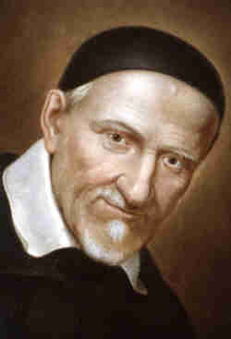

St. Vincent de Paul
Frank joined the St. Vincent de Paul Society in 1913.
St. Vincent de Paul
Notes:
On October 22, 1913 a coworker, Jack O’Callaghan, invited Frank to join the St. Vincent de Paul Society. He began working with the Society, serving the poor.

Slide 13
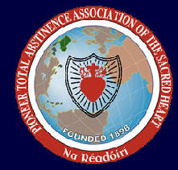
1914
Made 1st enclosed retreat
Daily Mass
Joined Pioneer Total Abstinence Association
Began private apostolate to lapsed Catholics
Notes:
In 1914, (click) Frank made his first of many enclosed retreats. (click) He began attending daily Mass for Lent, then continued after Lent was over and attended Mass daily for the rest of his life. (2 clicks) He joined the Pioneer Total Abstinence Association which was formed in 1898 to honor the Sacred Heart of Jesus by promoting prayer, and abstinence from alcohol. (click) He also began a private apostolate to lapsed Catholics.

Slide 14
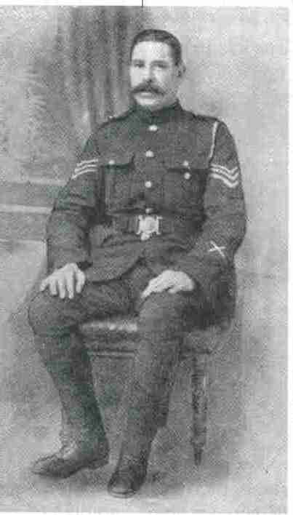
Joe Gabbett
Notes:
In 1914 many poor Catholics were attending Protestant services so that they would be fed breakfast. Frank met Joe Gabbett who was trying to counteract the effects of these proselytizing centers by starting a breakfast center of his own. Frank became his assistant in running the “Guild of the Immaculate Conception”. Each Sunday, they would serve breakfast and give a sermon on the Catholic Faith. Joe Gabbett is the one who introduced Frank to the Pioneer Association.

Slide 15
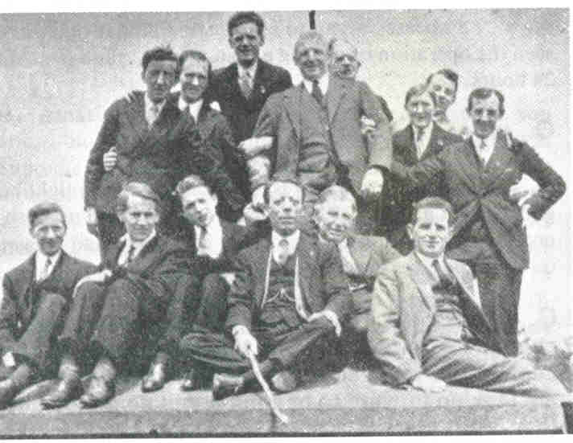
Retreats
Notes:
Frank began to organize annual retreats. Here is a later group of his on retreat at Mount Melleray Abbey.

Slide 16
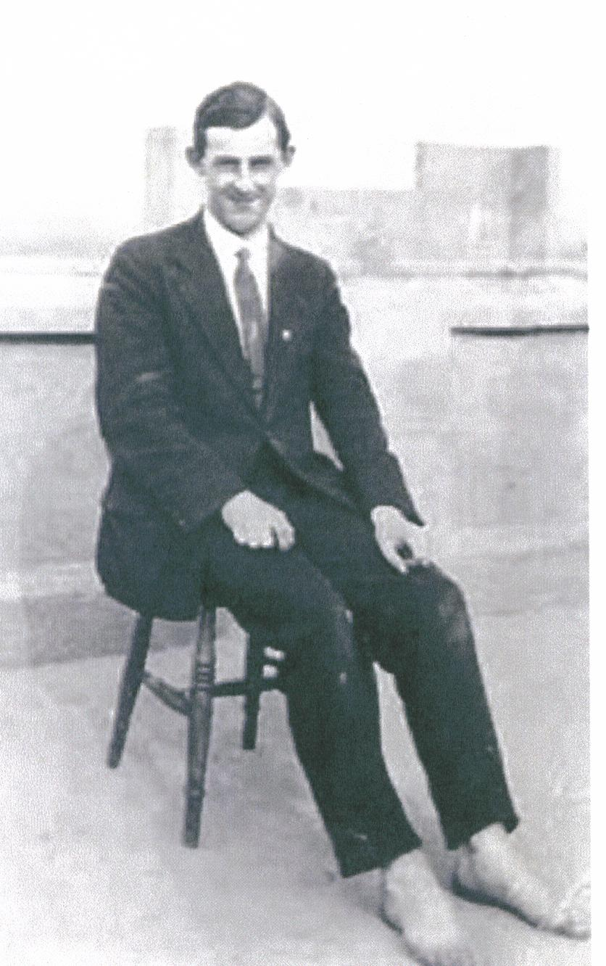
1915
Frank joined the Third Order of the Carmelites
Began praying the Little Office of Our Lady
Made 1st Pilgrimage to Lough Derg.
Barefoot at Lough Derg
Notes:
(click) In 1915, Frank joined the Third Order of the Carmelites, (click) began praying an office, and (3 clicks) he made the first of many pilgrimages to Lough Derg. Notice that he is barefoot in this photo – fasting and walking barefoot are traditional parts of the pilgrimage to this sanctuary of St. Patrick.

Slide 17
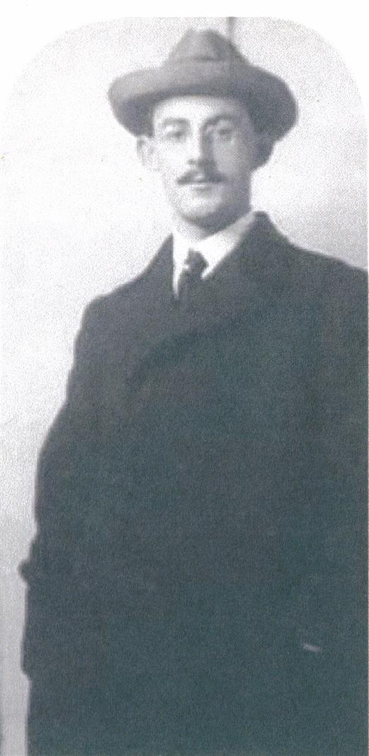
“Can We Be Saints?”
In 1916, Frank’s first booklet, “Can We Be Saints?” was published by the Catholic Truth Society of Ireland.
It has been described as a “plan of campaign for persons of apostolic intent.”
Notes:
In 1916, Frank’s first booklet, “Can We Be Saints?” was published by the Catholic Truth Society of Ireland. It has been described as a “plan of campaign for persons of apostolic intent.”
This photo shows Frank Duff around the time the booklet was written.

Slide 18
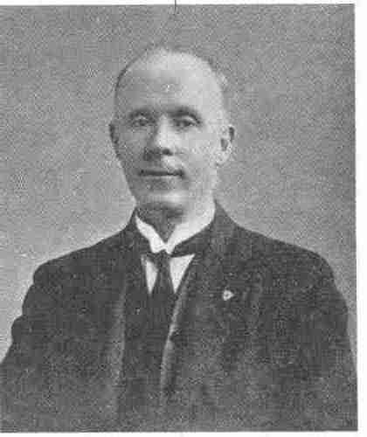

1918
Tom Fallon introduced Frank to St. Louis Marie de Montfort’s True Devotion to Jesus Through Mary
Notes:
Tom Fallon, who had joined Frank in the picketing of the proselytizing center, encouraged him to read de Montfort’s book on True Devotion. Frank read it several times but felt he could not fully grasp it.

Slide 19
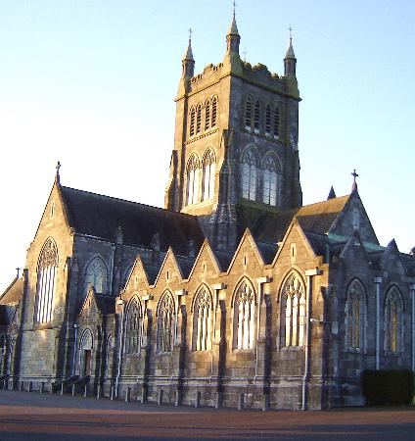
Mount Melleray
Notes:
Finally, in 1919, on a retreat at Mount Melleray, Frank was given the book “Knowledge of Mary” by Fr. De Concilio. This filled in the gaps in his understanding of Mary and made the True Devotion clear to him, which laid the foundation on which the Legion of Mary was built.

Slide 20
Founding the Legion
Notes:
The Legion of Mary was born on September 7, 1921.

Slide 21
What led up to it:
St. Vincent de Paul Conference divides into two
Frank becomes president of the St. Patrick’s Conference
New works are introduced, some involving women
The female members become interested in the men’s apostolate to Dublin Union Hospital
Notes:
(click) In 1917, the St. Nicholas of Myra Conference of the St. Vincent de Paul Society, divided into two conferences and (click) Frank Duff became president of the new St. Patrick’s Conference. (click) This group began several new works including teaching catechism to spiritually neglected children, running a Pioneer Total Abstinence Center, and promoting the League of daily Mass, Enthronement of the Sacred Heart, and enrollment in the Brown Scapular. Because some of these works were directed towards women, the society began to enlist the help of women. (click) The female volunteers became interested in some of the apostolates that were traditionally done only by men.

Slide 22
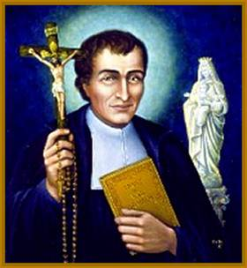
True Devotion
“It is impossible to believe that the connection between the ‘True Devotion’ meeting and the immediate emergence of the Legion was a mere coincidence. The moment it established in minds the true stature of Our Lady in the Christian system, things were ready for the Legion.”
- Frank Duff
St. Louis Marie de Montfort
Notes:
At the same time, Frank was spreading the word about de Montfort’s True Devotion. Many people were interested, so an evening meeting was set up. Frank gave a talk on the topic, which was followed by much discussion. As a result of this discussion, a group of women decided to meet and become involved in the hospital visitation. Frank Duff later wrote: (click) “It is impossible to believe that the connection between the ‘True Devotion’ meeting and the immediate emergence of the Legion was a mere coincidence. The moment it established in minds the true stature of Our Lady in the Christian system, things were ready for the Legion.”

Slide 23
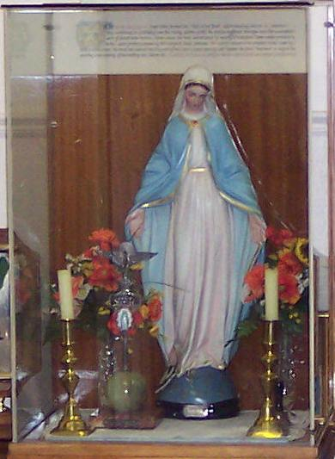
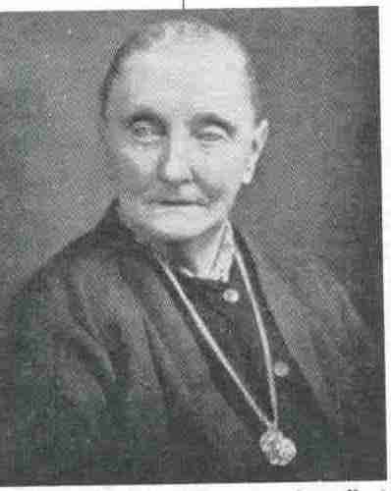
Wednesday, September 7, 1921
8:00 p.m.
Vigil of the Feast of Our Lady’s Nativity
Notes:
A meeting was set up for September 7th. Those who were there did not realize until later that it was the vigil of Our Lady’s birthday. In attendance were Frank Duff, Father Toher, and thirteen women. (click) Alice Keough set up this altar (which is now on display in the Legion headquarters in Dublin.) (click) The first president was Elizabeth Kirwin. The first work was visitation of patients in South Dublin Union Hospital. And the first name given to the new organization was the “Association of Our Lady of Mercy.”

Slide 24
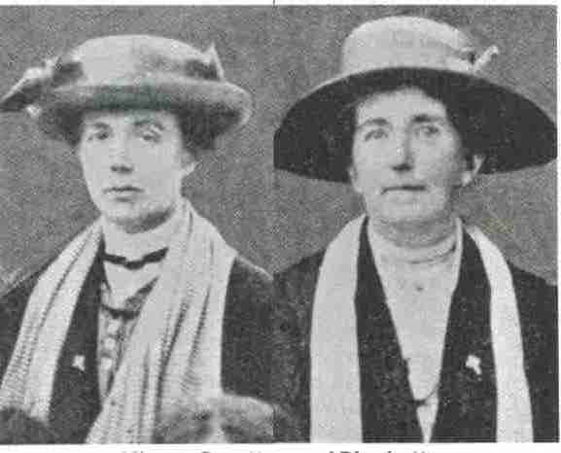
A Second Branch
Notes:
Soon a second branch, called “Our Lady of the Sacred Heart,” was set up. Two of its early members, Rose Scratton and Josephine Plunkett, are shown here. This group tackled the problem of prostitution, making extensive visits to street girls and inviting them to make an enclosed retreat. The story of the miraculous results of these retreats is told in the book “Miracles on Tap”.

Slide 25
The Hostels
1922: Sancta Maria Hostel
1927: Morning Star Hostel
1930: Regina Coeli Hostel
Notes:
The amazing result of these enclosed retreats was that most of the street girls left their way of life. This necessitated a suitable place for them to go to following the retreats. So, (click) in 1922, Sancta Maria Hostel was set up. (click) In 1927, Morning Star Hostel was set up to accommodate down-and-out men. (click) And, in 1930, Regina Coeli Hostel was opened to serve destitute women, unmarried mothers, and their children.

Slide 26
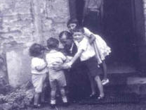
Notes:
Frank’s life began to revolve around these hostels. In Regina Coeli, he knew all of the children by name. (By the time he died, it was estimated that almost 4000 children had been raised there.)

Slide 27
Extending the Legion
Notes:
By 1925, the organization had taken the name “Legion of Mary”. It quickly spread throughout Ireland and, by 1928, reached beyond that country.

Slide 28
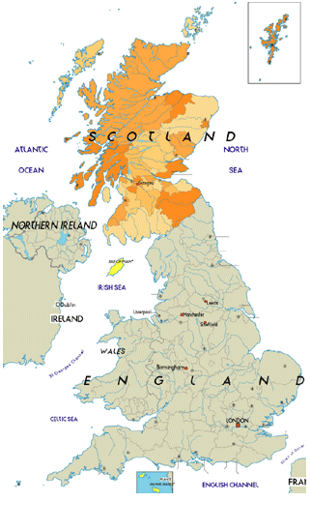
Outside Ireland
1928: Scotland
1929: England
1931-1933: rapid expansion throughout the world
Notes:
(click) Frank traveled to Scotland in 1928 and was successful in starting the Legion there. The bishop asked him for something in writing about the Legion and this became the occasion of the writing of the first Legion of Mary handbook. (click) By 1929 it had spread to England and (click) by 1931 it had begun to spread quickly throughout the world.

Slide 29
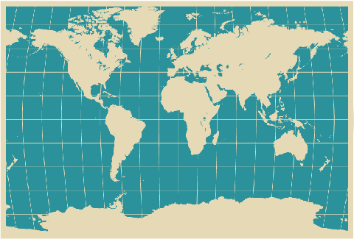
Around the Globe in 1931
New Mexico, United States
India
Australia
Notes:
In the summer of 1931, Fr. Joseph Donovan visited Dublin and observed the workings of the Legion of Mary. He wrote an article about his experiences in the “Denver Review”. (click) Later that year, Frank Duff received a letter from the pastor of St. Patrick’s parish in Raton, New Mexico. He had read the article and was making further inquiries. The first praesidium meeting in America was held at St. Patrick’s on November 27th, 1931. Also that year, the Legion spread to both (click) India and (click) Australia.

Slide 30
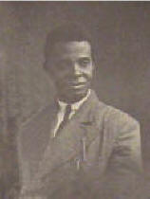
Africa
Notes:
By 1933, the Legion had also spread to Africa. The first legionary in Africa was Michael Ekeng, a former slave boy, who became the first praesidium president on September 7th, 1933, exactly twelve years after the start of the Legion in Dublin.

Slide 31
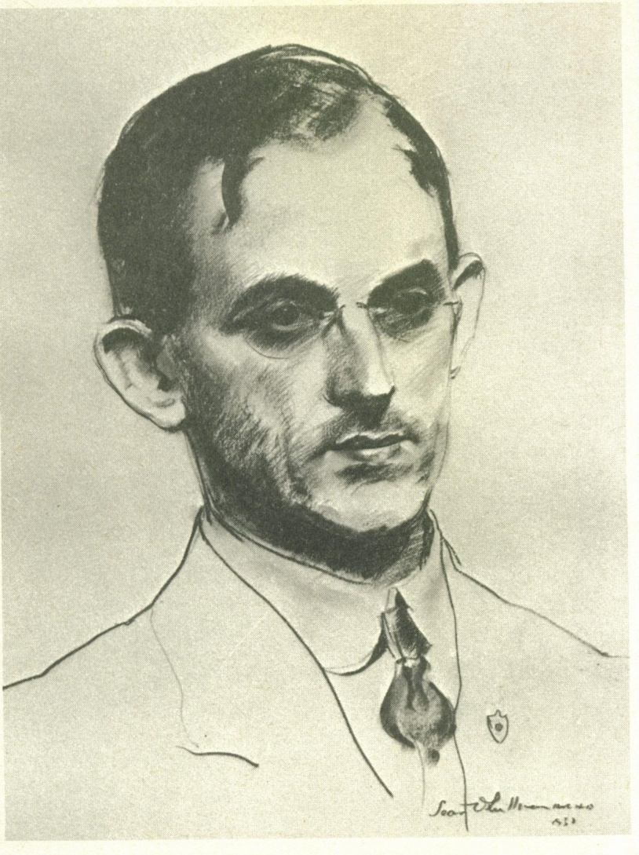
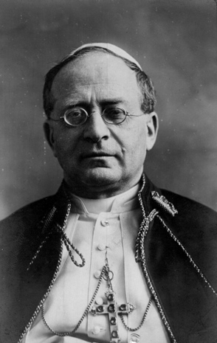
Primary Reasons for Expansion
“
“With all my heart I express that desire.”
Notes:
There were two primary reasons for the great growth of the Legion in the 1930s. (click) In 1931, Frank Duff made his first trip to Rome where he had a twenty minute audience with Pope Pius XI (click) who was known as the Pope of Catholic Action. When the Holy Father asked Frank Duff what he wished the Pope would do for him, Frank said: “If we could say that it was the personal desire of Your Holiness that the Legion of Mary would spread over the whole world, this would be a great mode of propaganda for spreading the Legion.” The Holy Father responded, (click) “With all my heart I express that desire.”

Slide 32
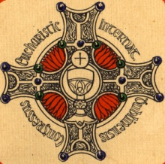
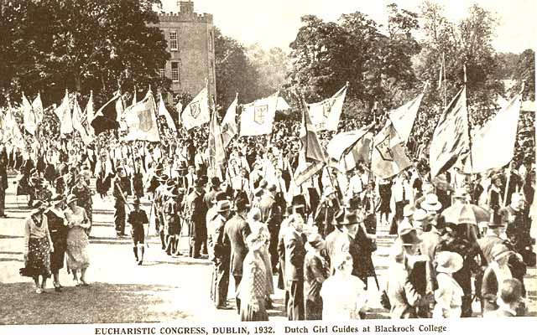
31st International
Eucharistic Congress
Notes:
The second reason for the rapid growth of the Legion was that the International Eucharistic Congress was held in Dublin in 1932. Bishops and priests from all over the world came to Dublin and were introduced to the Legion in the course of their stay. The Bishops of St. Louis and Los Angeles asked for help starting the Legion in their dioceses, and in 1934, Mary Duffy became the 1st Legion envoy to the United States and helped the Legion to spread throughout the USA.

Slide 33
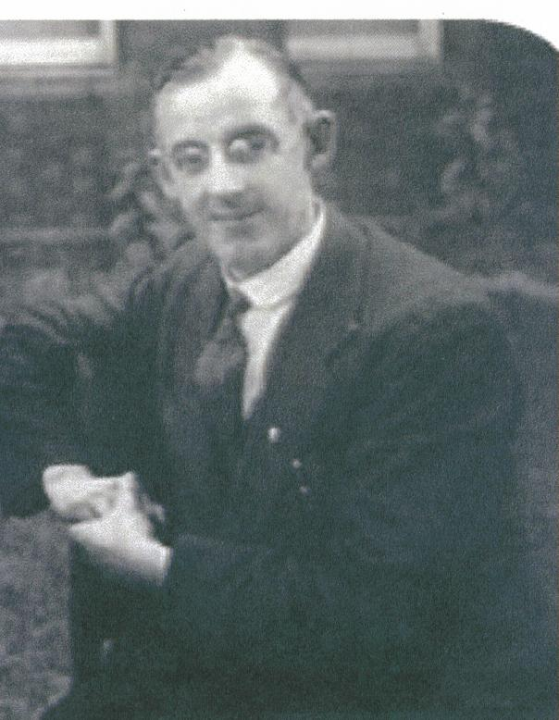
In 1934, at the age of 45, Frank Duff retired from the Civil Service to devote all of his time to the Legion of Mary.
Notes:
In 1934, at the age of 45, Frank Duff retired from the Civil Service to devote all of his time to the Legion of Mary. He set up his headquarters at Regina Coeli (which was next door to his home) and he spent many hours a day in correspondence with legionaries all over the world.

Slide 34
Envoys & Others
Notes:
During the next few decades, the Legion spread through the efforts of envoys, legionaries who would give years of their lives to work extending the Legion in other countries.

Slide 35
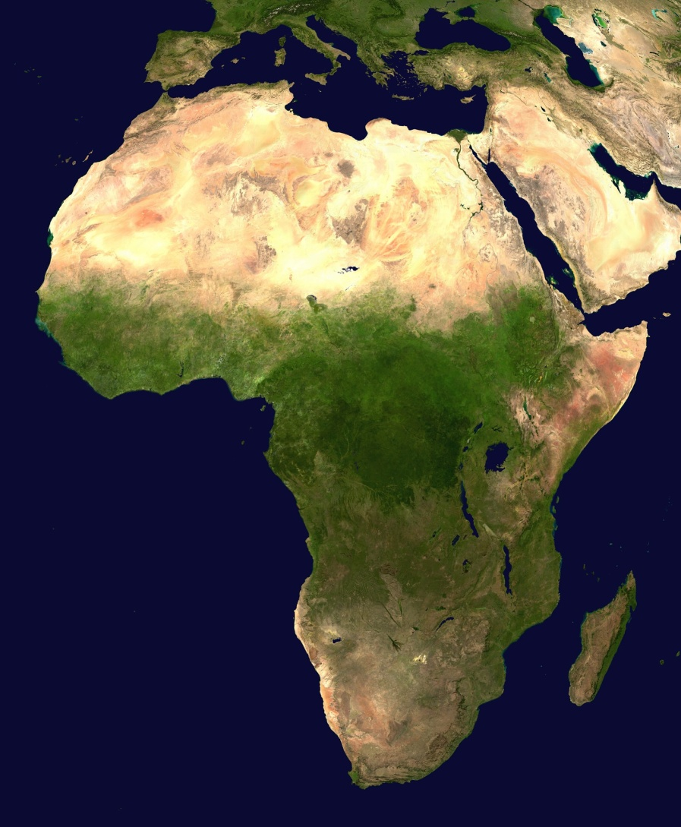
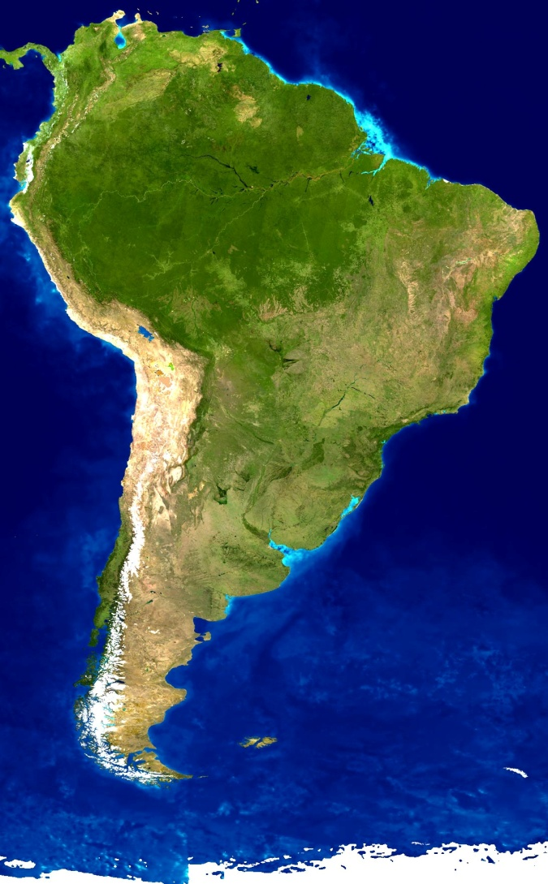
SOUTH
AMERICA
AFRICA
Notes:
The Legion would spread to and flourish in the continents of Africa and South America.

Slide 36
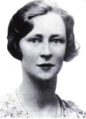

Edel Quinn
Born: 9/14/1907
Envoy: 1936-1944
Died: 5/12/1944
Notes:
In 1936, Frank Duff asked Edel Quinn to go to Africa as an envoy. Although she was ill, suffering from tuberculosis, she gladly accepted and successfully extended the Legion throughout East and Central Africa. She died in Nairobi on May 12, 1944. She was declared “Venerable” by Pope John Paul II on December 15, 1994. Here we see Frank Duff with Edel Quinn as she is about to leave for Africa.

Slide 37
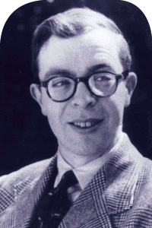
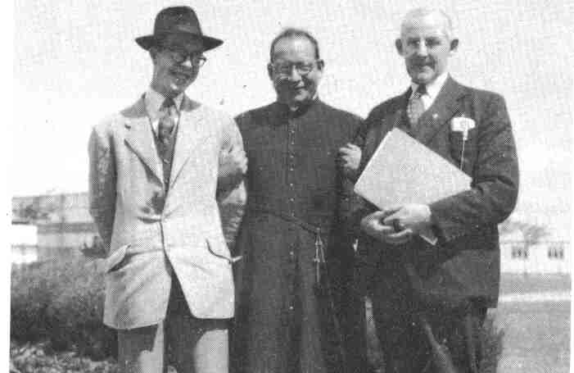
Alfie Lambe
Born: 6/24/1932
Envoy: 1953-1959
Died: 1/21/1959
Notes:
Alfonsus Lambe was inspired to join the Legion as a very young man after hearing a talk given by Frank Duff. At the age of 21 he left Dublin to work as a Legion envoy in South America, where he had amazing success. After a short but grave illness he died in Buenos Aires on January 21, 1959. He is seen here with Frank Duff shortly before leaving for South America.

Slide 38
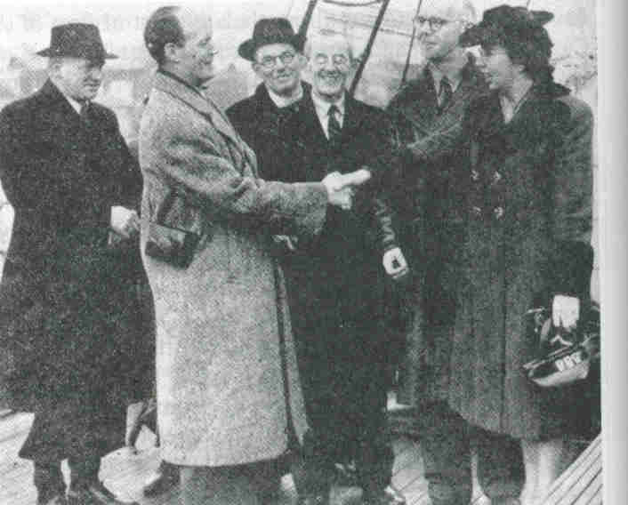
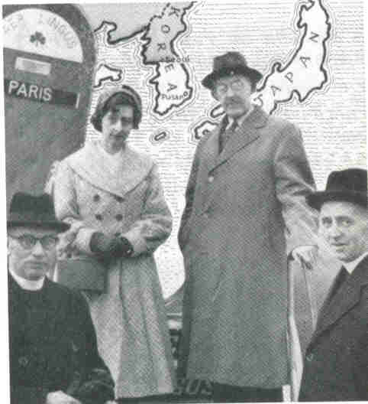
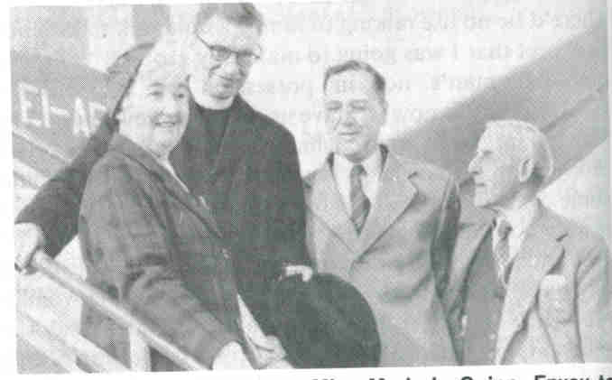
Other Envoys
Notes:
(click) John Murray and Mary Duffy, two envoys to America, are seen here with Frank Duff and others. (click) Marjorie Quinn, envoy to Algeria and Tunisia is being seen off at the airport by Frank Duff, John Gavin, and Fr. O’Floinn. (click) Joan Lynch is seen here with Frank Duff just before departing for Thailand and South Vietnam.

Slide 39
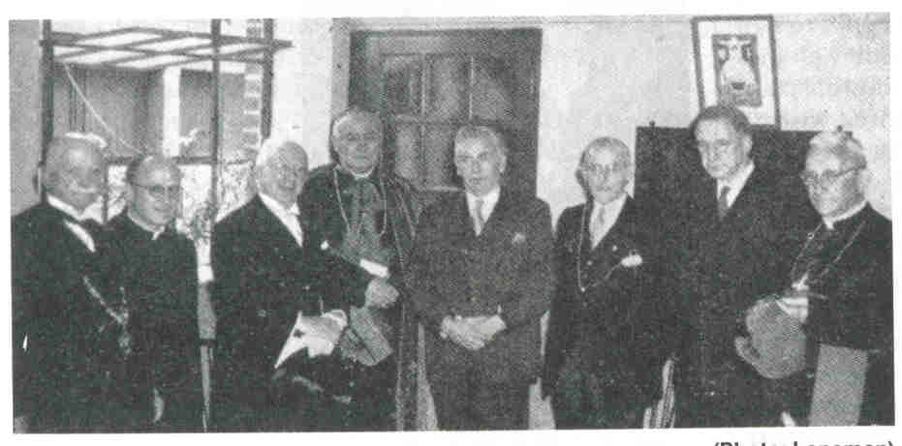
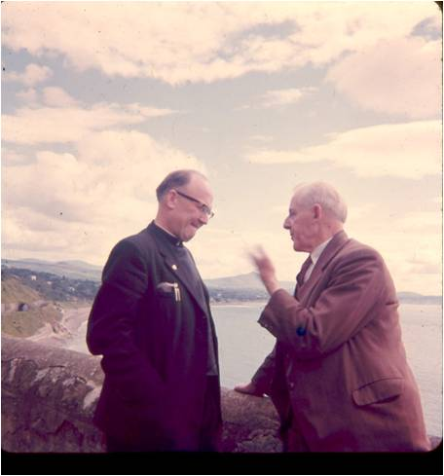
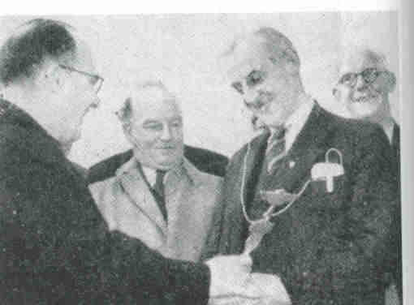
Fr. Aedan McGrath
Notes:
(click) Fr. Aedan McGrath, a Columban Father, first met Frank Duff in 1946. At the request of Archbishop Riberi, Internuncio to China, he founded the Legion all over China just before the Communist takeover. He described Frank Duff as his “constant correspondent and advisor” during that time. (click) Here he is seen being presented with a Legion Vexillum by Frank Duff on his return to Dublin after spending three years in a Communist prison in Shanghai. Over 10,000 Chinese legionaries were imprisoned and over 1,000 were martyred. (click) Fr. McGrath and Frank Duff are shown here at a reception in Father’s honor along with the Lord Mayor of Dublin and the President of Ireland.

Slide 40
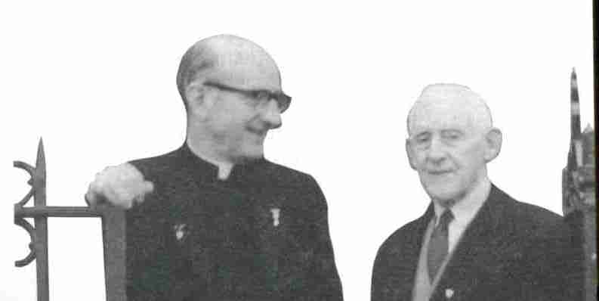
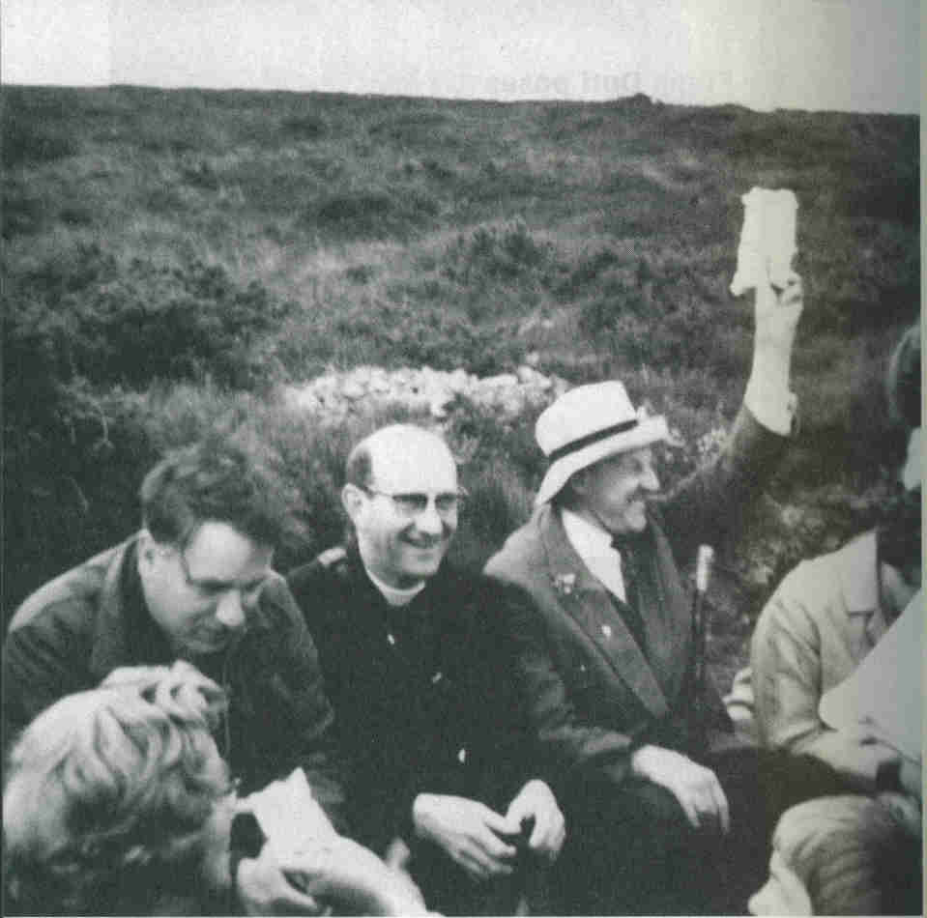
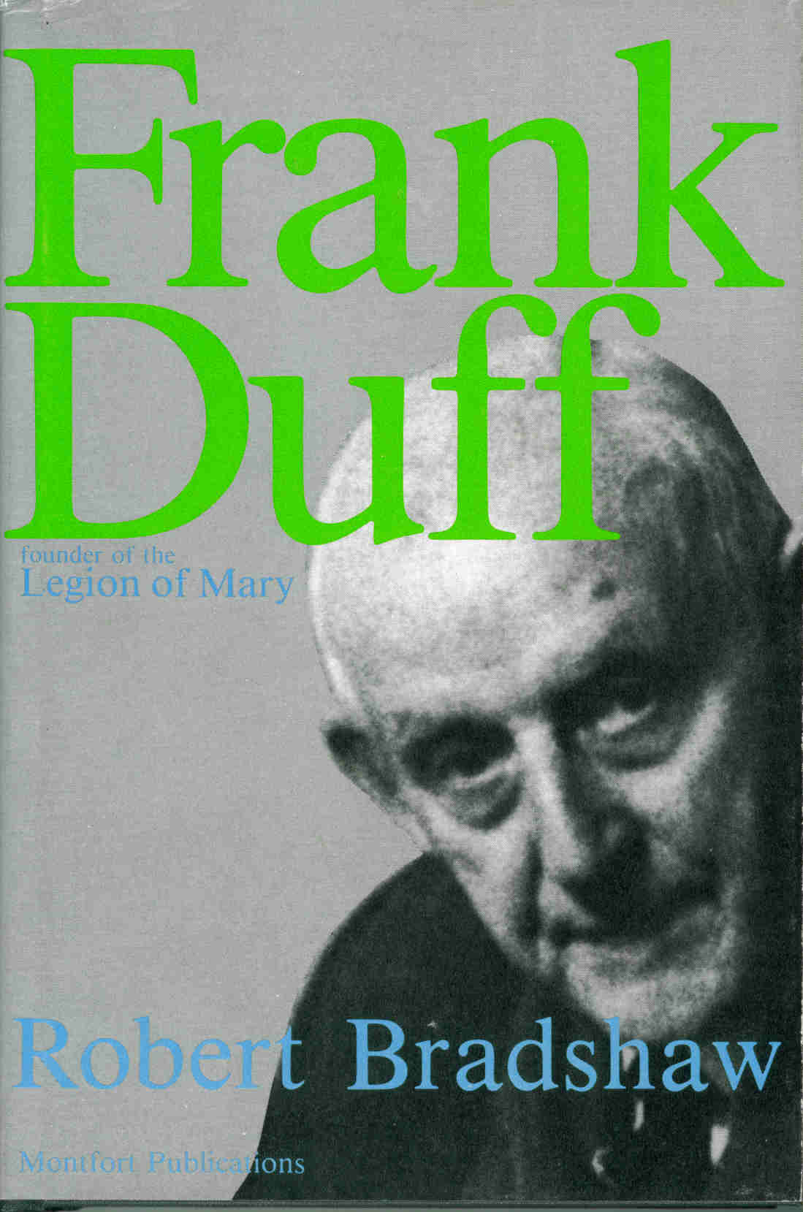
Fr. Robert Bradshaw
Notes:
Fr. Robert Bradshaw first met Frank Duff in 1955 and became a close friend. (click) He would bring the Legion to Iceland and Siberia. (click) Father wrote the biography of Frank Duff that much of this presentation is based upon.

Slide 41
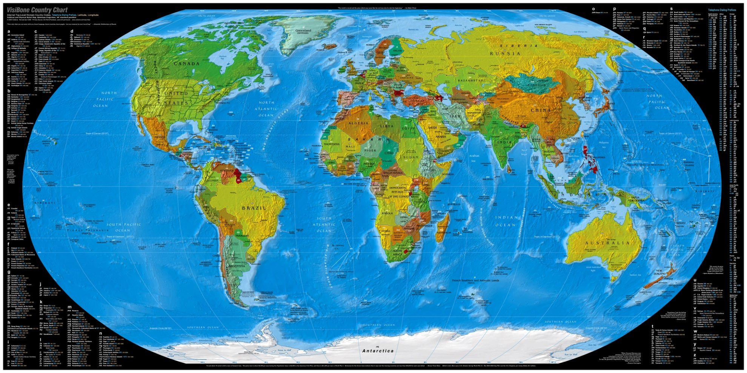
Notes:
As the Legion spread around the globe, Frank spent much of his time corresponding with envoys and new legionaries. Over his lifetime, he would write about 33,000 letters (most of which were typed, single-spaced, and several pages long!)

Slide 42
Marianist Award
Notes:
As the Legion spread, Frank Duff began to receive attention from Catholics around the world.

Slide 43
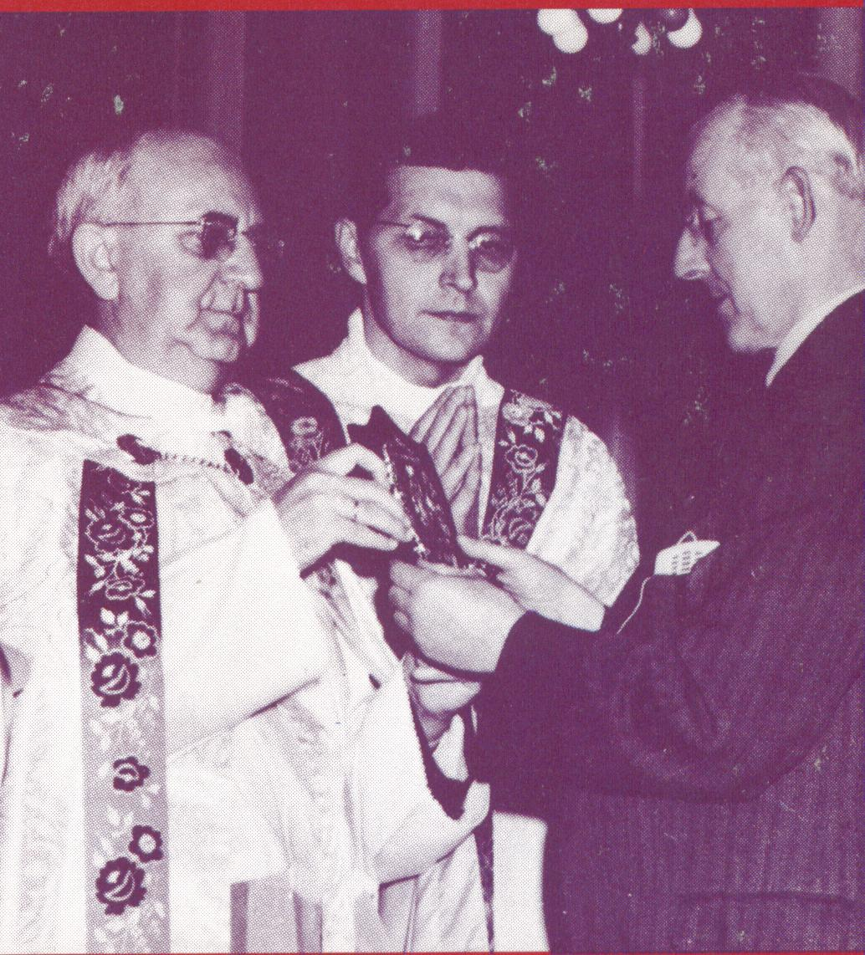
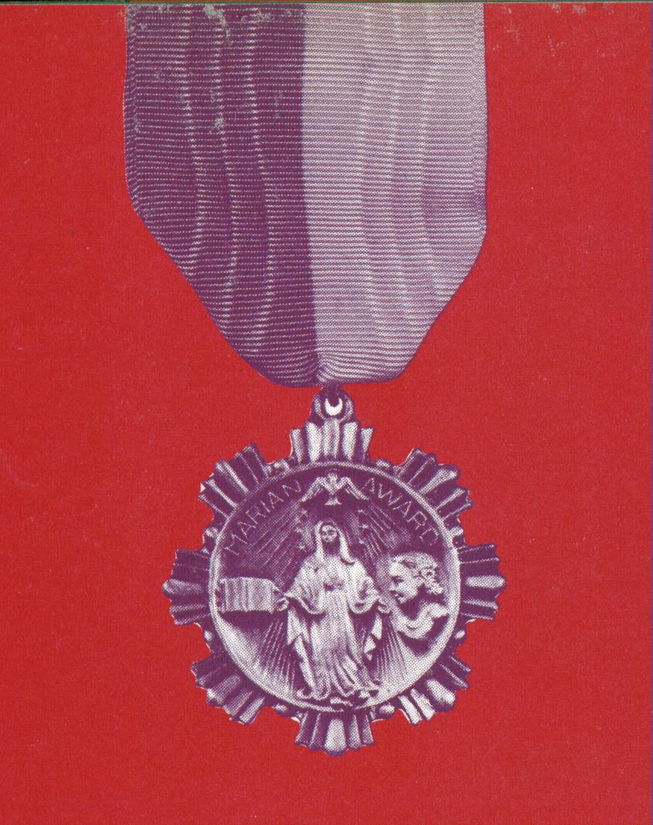
December 8, 1956
Notes:
On December 8, 1956, Frank Duff was honored by the University of Dayton, Ohio, with its seventh annual award offered in public recognition to those who have rendered outstanding service in America to the Immaculate Mother of God. (click) He was presented the award by Very Rev. John Elbert, Provincial of the Cincinnati Province of the Society of Mary. Fr. Leimkuhler of the University of Dayton stated, “Because of your outstanding character as a Catholic layman in having dedicated yourself unreservedly and so modestly to the founding and directing of this great association of Catholic men and women, known the world over as the Legion of Mary, the University of Dayton is greatly pleased to confer upon you the highest honor within her power to bestow – The Marianist Award.”

Slide 44
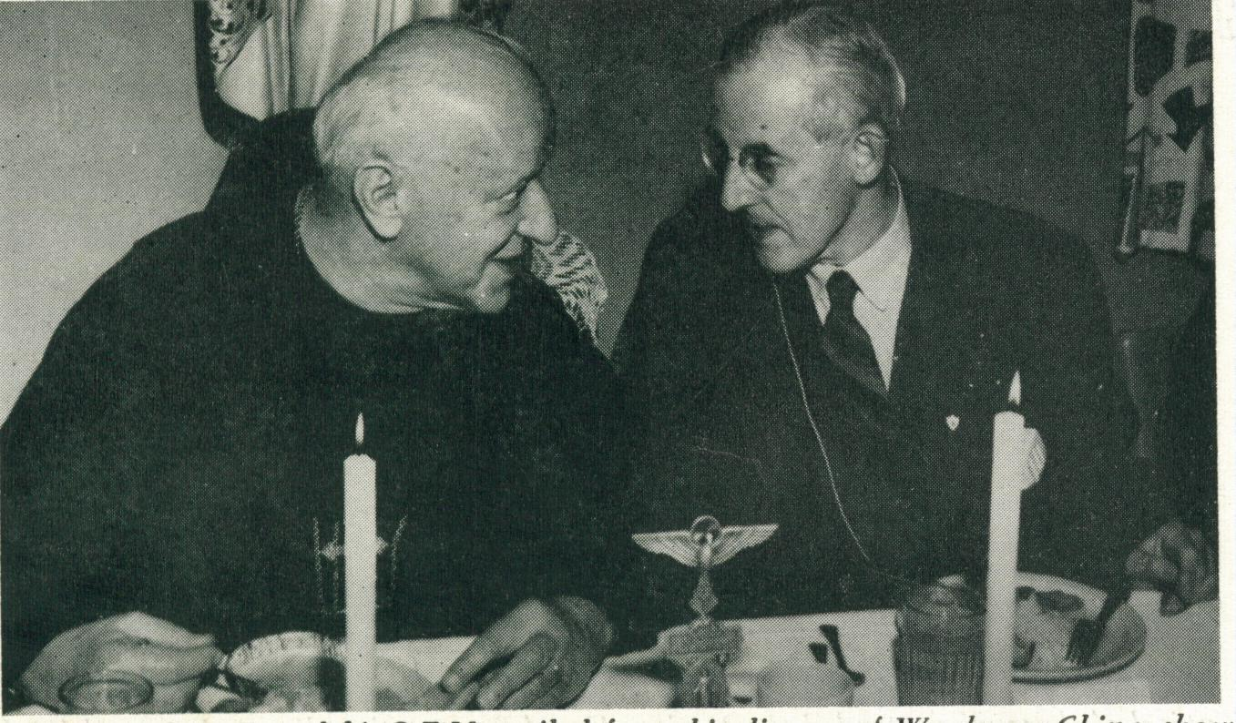
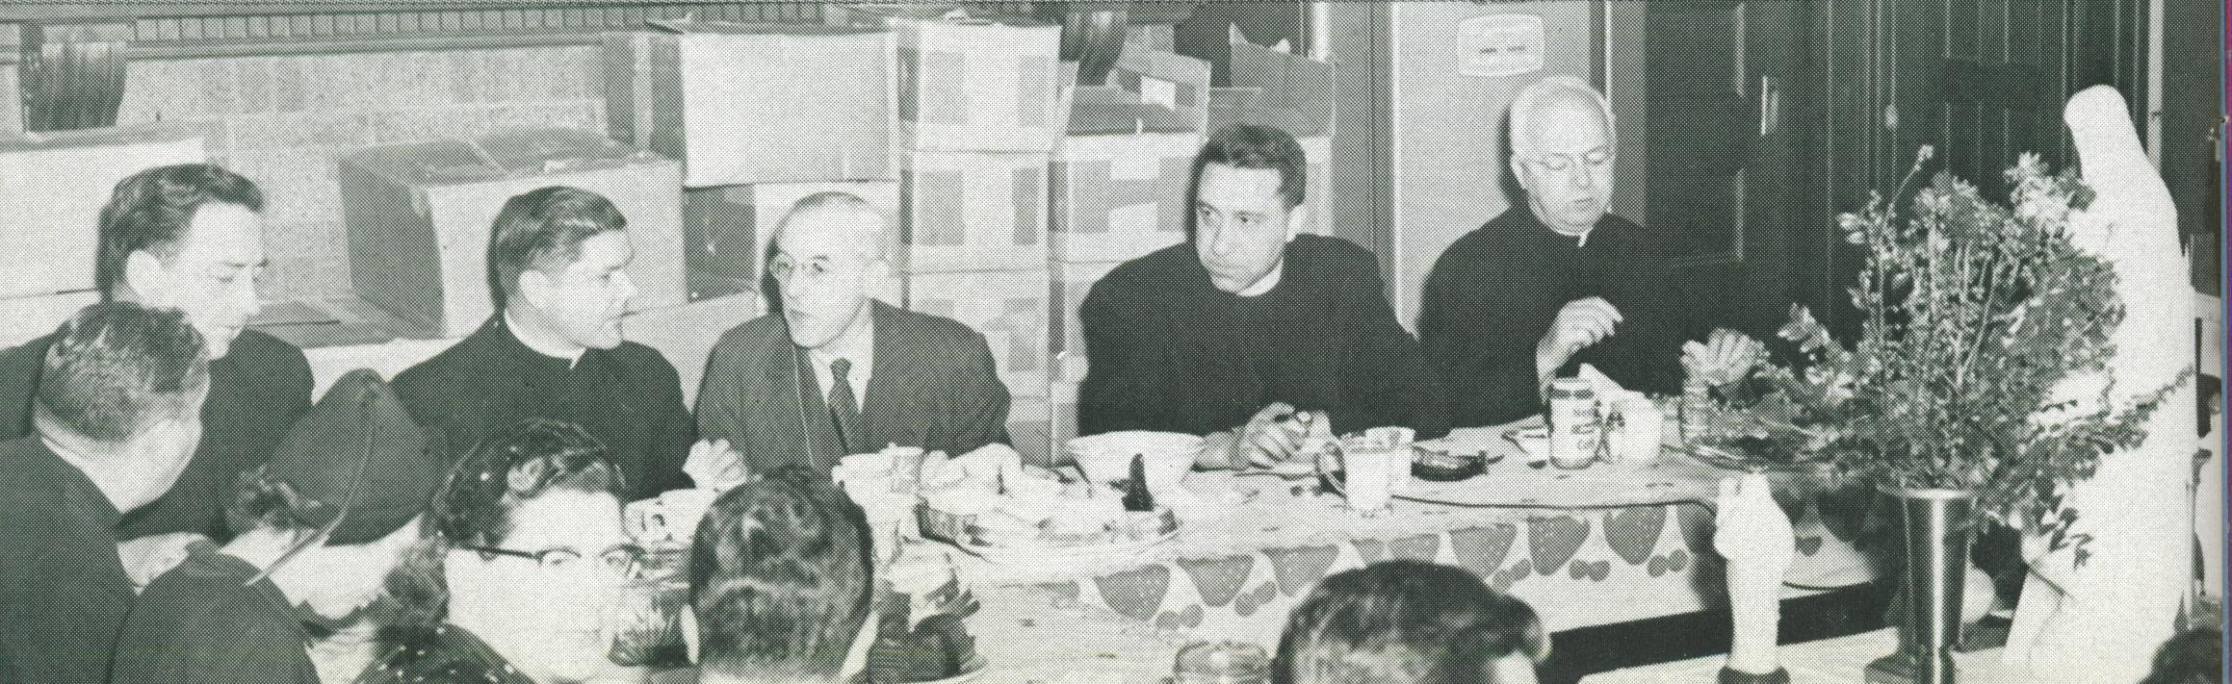
“There is no saying that could be addressed to me that would give me greater pleasure than to tell me I have served Our Lady.”
Notes:
(click) At the reception following, we see Frank speaking with Bishop Kowalski who was exiled from his diocese of Wuchang, China and who had spent over two years in a Communist prison. In Br. Duff’s speech following the meal, he said, (click) “I suppose that there is no saying that could be addressed to me that would give me greater pleasure than to tell me that I have served Our Lady.” (click) Frank Duff also visited Queen of All Hearts magazine. Queen magazine promoted de Montfort’s writings and often published articles by Br. Duff.

Slide 45
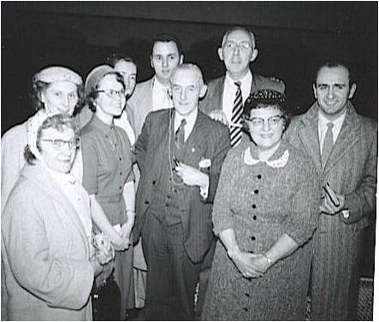




His Only Trip to the USA
Notes:
Frank Duff did very little traveling outside of the United Kingdom. He took his mother to France on vacation and made a couple of trips to Rome, but the trip to Dayton was his only trip to the United States. During his time here, he met with legionaries in Ohio, New York, and Maryland. He gave several talks to legionaries as well as an address to 250 seminarians. He began one talk to a group of legionaries by saying, “No, do not be expecting any miraculous utterance from me. I’m just Brother Duff coming among my brothers and sisters . . . to chat with them.” He went on to speak about the Legion’s role in the Mystical Body of Christ. Here are a few photos taken in New York as he visited with legionaries.

Slide 46
In Dublin
Notes:
Frank Duff’s life in Dublin was filled with Legion business from around the world.

Slide 47





Notes:
Br. Duff loved to welcome legionaries from around the world who would come to study the Legion in its original setting. Legionaries from the Philadelphia Senatus made several trips in the late fifties and early sixties. (click) Here is Br. Duff with Fr. Szal. (click) Here he is leading a group of Philadelphia legionaries through the streets of Dublin – the baby he is carrying is me! (click) Here he is with Al Norrell and Mary (McFadden) Brady. (click) And here he is giving a tour for a bus full of Philadelphians.

Slide 48




Notes:
At least twice a year, Frank liked to take a lengthy bicycle trip. He would travel with a group of legionaries that he nicknamed “The Sprockets”. He was a great photographer and on these trips, would take many photos which he would then show as slide presentations to groups of legionaries. He was also an avid reader, an inventor, and an author. He had a busy life.

Slide 49
Vatican II
Notes:
The 1960s brought some new challenges for Frank Duff. He suffered a stroke and spent five months recuperating in 1963 and 1964. But, having recovered, he was summoned to Rome in 1965 at the age of 76 to be an official Lay Observer at Vatican Council II.

Slide 50

Lay Observer
Notes:
The main reason for Br. Duff’s invitation to Rome was that many of the things the Council Fathers were discussing had been advocated by Frank Duff as far back as 1921 and were already incorporated into the Legion’s handbook and system.

Slide 51
The Apostolate of the Laity
“In their catechetical instructions, their ministry of the word, their direction of souls, and in their other pastoral services priests should be preoccupied with forming apostles.”
“When the apostolate is one of making the gospel known and man holy, the laity must be specially formed to engage in conversation with others, believers or non-believers, in order to manifest Christ’s message to all men.”
- Vat. Council 2, Laity – 30, 31
Notes:
One of the sessions of the Council that Frank Duff was present for was The Apostolate of the Laity. Since the start of the Legion he had promoted “the doctrine of the Mystical Body and the consequent duty of the laity to be apostolic.” (Bradshaw, p. 198) He was thrilled then when the Council Fathers decreed: (click)“In their catechetical instructions, their ministry of the word, their direction of souls, and in their other pastoral services priests should be preoccupied with forming apostles.”
and (click) “When the apostolate is one of making the gospel known and man holy, the laity must be specially formed to engage in conversation with others, believers or non-believers, in order to manifest Christ’s message to all men.”

Slide 52


Appreciation
Notes:
It was evident to many of the Council Fathers that the Legion of Mary was ahead of its time. At one point during the Sessions, “Cardinal Heenan of England (click) drew the attention of the 2,500 bishops to the presence of Frank Duff in their midst. (click) There was loud and sustained applause, a sincere gesture of appreciation from the hierarchy for what this layman had done for the Church.” (Bradshaw, p. 198)

Slide 53

Work
32 formal talks to different groups of bishops
interviews
articles
over 200 letters
Notes:
Frank Duff worked tirelessly, spreading word of the Legion, during his three months in Rome. (click) He gave at least 32 formal talks to different groups of bishops, (click) gave many personal interviews, (click) wrote articles and memos, and (click) wrote over 200 letters. This was an amazing feat for someone who had recently recovered from a stroke.

Slide 54

Pope Paul VI
“Mr. Duff, I want to thank you for your services to the Church and also to express appreciation for all that the Legion of Mary has done.”
“The Legion of Mary has served the Church faithfully, and the Church will protect the Legion.”
Notes:
The highlight of the trip was his private audience with Pope Paul VI on December 11th, 1965. The Holy Father said to him, (click) “Mr. Duff, I want to thank you for your services to the Church and also to express appreciation for all that the Legion of Mary has done.” When Br. Duff thanked the Holy Father and assured him of the Legion’s loyalty to the Pope and his priests and bishops “even to the point of martyrdom”, the Holy Father added, (click) “The Legion of Mary has served the Church faithfully, and the Church will protect the Legion.”

Slide 55

Another Papal Meeting
“Victory will come through Mary.”
Notes:
Fourteen years later, in May of 1979, Frank Duff would receive a special invitation from Pope John Paul II. Br. Duff and three other legionaries had the privilege of attending Mass and breakfast with the Holy Father. The Pope said that his message to the Legion was, (click) “Victory will come through Mary."

Slide 56
TV
Notes:
Through the 1960s and 1970s, the Legion continued to grow and thrive throughout the world and its Golden Jubilee was celebrated in 1971. In 1975, Frank’s sister, Sara Geraldine, died, leaving him the only surviving member of his family. He continued his full-time activity in the Legion although he was well into his eighties.

Slide 57

Monsignor Moss
Notes:
Frank Duff had several illnesses during the 1970s, including a serious illness in 1979. Msgr. Charles Moss, a Legion spiritual director in the Philadelphia Senatus area, felt the urgency to record Br. Duff while he was still up to being interviewed. Monsignor gathered a team of legionaries to travel to Dublin for the purpose of taping a series of television interviews with Br. Duff.

Slide 58



The Team
Notes:
The team consisted of Walter Brown, Al Norrell, Bill Peffley, and Bea Flanagan. In August of 1979, they made a series of video recordings of the Legion founder. Frank Duff was 90 years old.

Slide 59



Notes:
Msgr. Moss said of Frank Duff: “As a tv personage, (click) Mr. Duff was truly amazing. He would sit under the lights and patiently endure our half-hour of testing each day (click) and then continue under those lights for another hour or two or even three and never complain. He was convinced of the value of these recordings for the future good of the Legion. For a man of ninety, he was amazingly spry. The day after we concluded our videotaping, he went on a cycling trip to the west of Ireland!” (click) Msgr. later edited a book that included the transcripts of these interviews.
“

Slide 60
Farewell
Notes:
Although Frank Duff continued his usual routine through the next year, those around him could see that he was tired.

Slide 61

Joan Cronin
Notes:
On Friday, November 7, 1980, Frank Duff attended the funeral of a legion envoy, Joan Cronin. When he returned from the funeral, he told his housekeeper, Nellie Jessop, that he was not feeling well. He went up to his bed and around 4:00, when Nellie brought him a cup of tea, she found that he had died.

Slide 62

Notes:
Nellie described him as sitting in the bed with his arms across his chest. He was staring at the picture of the Sacred Heart that was across from his bed. He had died quietly and simply.

Slide 63
Oh, my God, I do not ask for the big things - the life of the missionary or the monk, or those others I see around me so full of accomplishment.
I DO NOT ASK FOR ANY OF THESE; BUT SIMPLY SET MY FACE TO FOLLOW OUT UNSWERVINGLY, UNTIRINGLY, THE COMMON LIFE WHICH DAY TO DAY STRETCHES OUT BEFORE ME, SATISFIED IF IN IT I LOVE YOU, AND TRY TO MAKE YOU LOVED.
NATURE REBELS AGAINST THIS LIFE WITH ITS NEVER-ENDING ROUND OF TRIVIAL TASKS AND FULL OF THE TEMPTATION TO TAKE RELIEF IN AMUSEMENT OR CHANGE.
IT SEEMS SO HARD TO BE GREAT IN SMALL THINGS, TO BE HEROIC IN THE DOING OF THE COMMONPLACE; BUT STILL THIS LIFE IS YOUR WILL FOR ME. THERE MUST BE A GREAT DESTINY IN IT.
AND SO, I AM CONTENT.
AND THEN TO CROWN THE REST, DEAR JESUS, I BEG YOU TO GIVE ME THIS, FIDELITY TO THE END, TO BE AT MY POST WHEN THE FINAL CALL COMES, AND TO TAKE MY LAST, WEARY BREATH IN YOUR EMBRACE.
A VALIANT LIFE AND FAITHFUL TO THE END.
A SHORT WISH, DEAREST JESUS, BUT IT COVERS ALL.
Notes:
As a young man of 27, Frank had composed this prayer: (click)"Oh, my God, I do not ask for the big things - the life of the missionary or the monk, or those others I see around me so full of accomplishment, (CLICK) I do not ask for any of these; but simply set my face to follow out unswervingly, untiringly, the common life which day to day stretches out before me, satisfied if in it I love You, and try to make you loved. (CLICK) Nature rebels against this life with its never-ending round of trivial tasks and full of the temptation to take relief in amusement or change. (CLICK) It seems so hard to be great in small things, to be heroic in the doing of the commonplace; but still this life is Your will for me. There must be a great destiny in it. (CLICK) And so, I am content. (CLICK) And then to crown the rest, dear Jesus, I beg you to give me this : fidelity to the end, to be at my post when the final call comes, and to take my last, weary breath in Your embrace. (CLICK) A valiant life and faithful to the end. (CLICK) A short wish, dearest Jesus, but it covers all. "
This was a very prophetic prayer.

Slide 64

Notes:
Over a period of several days, Frank’s body was laid out in the Regina Coeli Hostel Chapel. Thousands of legionaries from around the world filed past his coffin as well as government officials, bishops, priests, and religious.

Slide 65


Notes:
On Wednesday, November 12th, His Lordship Most Reverend James Kavanaugh, the Auxiliary Bishop of Dublin, recited the prayers for the repose of Br. Duff’s soul at St. Andrew’s Church. The homily was given by Canon Francis J. Ripley, spiritual director of the Senatus of Liverpool who had been a friend of Frank Duff’s for over 40 years.

Slide 66



Requiem Mass
Notes:
His Eminence, Cardinal Tomas O’Fiaich, the Primate of Ireland, was the main celebrant at the Solemn Requiem Mass at St. Andrew’s on November 13th. He preached the sermon. (click) The Concilium president, Br. Enda Dunleavy, a close personal friend of Br. Duff’s, gave the reading. (click) In attendance was the president of Ireland, Dr. Patrick J. Hillery.

Slide 67


Notes:
The funeral processed with a state escort to Glasnevin cemetery where Frank was buried in the Duff family grave. The Legion prayers and rosary were recited. The photo shows Fr. Thomas O’Flynn, Concilium spiritual director, Canon Ripley, and Fr. Aherne, spiritual director of the Regina Coeli praesidium.

Slide 68

Notes:
The Holy Father, Pope John Paul II, sent a telegram saying, “The Legion of Mary throughout the world mourns the death of its founder, Frank Duff. I join with the members in praying for the eternal repose of his soul. The Association that he founded has made countless lay Catholics aware of their indispensable role in evangelization and sanctification and has enabled them to fulfill that role zealously and effectively. To all legionaries, I impart the Apostolic Blessing and comfort in their loss and encouragement in their future task.”

Slide 69


Notes:
Br. Duff’s funeral card had a prayer for the Conversion of the World, something that he had prayed for and worked for during his entire life.

Slide 70
Servant of God
Notes:
In July 1996 the cause of Frank Duff’s canonization was introduced by the Archbishop of Dublin, Dr. Desmond Connell

Slide 71

A Man for Our Times
Notes:
As his cause is made known, people around the world are finding that Frank Duff is someone to whom everyone can relate.

Slide 72




Notes:
He has been described as (click) serious, (click) practical, (click) kind, (click) wise, and (click) strong.

Slide 73

Notes:
He was prayerful and led a sacramental life, centered around the Eucharist.

Slide 74




Notes:
He had a great love for children (click), for the poor (click), for his local Legion family (click), and for his Legion family around the world (click).

Slide 75

Notes:
Almost every description of him mentions his great sense of humor. Legionaries who knew him often recounted stories of the practical jokes he loved to play.

Slide 76

Notes:
Fr. Charest of Queen magazine called him “a warm, kindly, gentle-hearted man” who “had his hand on the pulse of the spiritual life of the Church everywhere.”

Slide 77

Notes:
He has been described as “philosopher, theologian, biblical scholar, possessor of vast knowledge on medicine, science and mathematics and a great communicator – able to express complex ideas in simple terms.”

Slide 78

heroic in doing the commonplace
immense desire to love God
great in the small things
an instrument with and through Mary & the Holy Spirit for the conversion of sinners and the
salvation of souls
Notes:
Frank Duff is a great model for all of us. Fr. Bede McGregor, concilium spiritual director and vice-postulator of the cause of Servant of God, Frank Duff wrote: “Frank Duff was (click) great in the small things, and (click) heroic in doing the commonplace, and his purpose in all things great and small was his (click) immense desire to love God and to be (click) an instrument with and through Mary and the Holy Spirit in the conversion of sinners and the salvation of souls.” (4 clicks)
Servant of God, Frank Duff, pray for us.

Slide 79
The End

